Slide 1
Evaluating School-Based Health Center Initiatives
The Center on Poverty and Community Development
Created August 2025

Slide 2

The Center on Poverty and Community Development
  Founded in 1988 at the Jack, Joseph, and Morton Mandel School of Applied Social Sciences to address inequality in Cleveland, OH
  Committed to providing quality data analysis and research that helps communities make decisions grounded in evidence to address the causes and consequences of poverty

Slide 3


Leadership
  Robert Fischer, PhD
  Director, Center on Poverty and Community Development
  Grace Longwell Coyle Professor in Civil Society
  Chair, Master of Nonprofit Organizations Program
  Francisca García-Cobián Richter, PhD
  Associate Director, Center on Poverty and Community Development
  Research Associate Professor
Notes:
Rob – intro self as Director, etc.
Francisca – Associate Director, research prof at Mandel

Slide 4
Learning Objectives
Learners will be able to...
  Identify the goals of evaluations
  Identify the types of evaluations
  Think through the steps to prepare for an evaluation
  Identify ways that evaluation findings can be used

Slide 5
What are Data?
Defined as facts that are often used as a basis for reasoning or decision-making¹²
Two main types of data:
  Quantitative: describes measurable values, such as numerical metrics or counts
    Ex. Survey scores, average height of a high school student
  Qualitative: describes characteristics that are not related to numbers, such as themes or experiences
    Ex. Themes from focus groups or interviews

Slide 6
What are Data? (Con't)
Data is one way to tell your story
Data is a way to represent people and their experiences

Slide 7

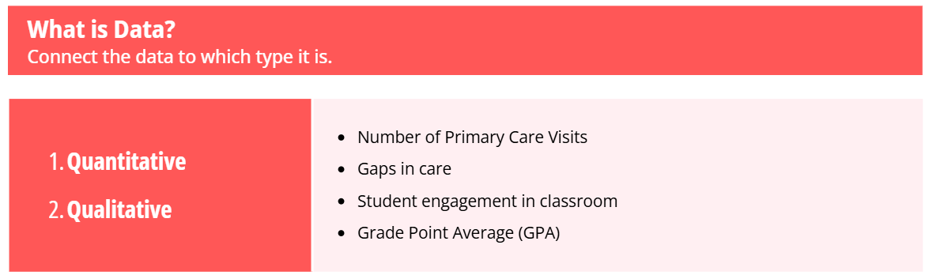
What are Data?

Slide 8
What are Data?

Slide 9
What is an Evaluation?
An evaluation is a way in which data is used to determine the value or quality of something¹³
  Data can be used to understand...
    How a program works
    How well a program is being carried out
    What value or results a program produces
Results are often used to inform decision-making
An evaluation can be used to tell a story about the people it represents

Slide 10
Purpose of Evaluation
  Examine SBHC impact on students, families, neighborhoods
  Develops a feedback loop to improve care, streamline processes, decision-making, and planning
  Supports the larger system of SBHC collaborators
    Findings can be used to secure additional funding, meet reporting requirements, and increase accountability
  National School-Based Health Alliance performance measures^{1,2}
Notes:
Evaluation of SBHC programming is a critical component of implementation. It allows staff, management, and funders to examine the impact of services on the students, families, and neighborhoods. Evaluation supports a feedback loop to improve care, streamline processes, support decision making, and enhance planning over time. Effective evaluation activities support the larger system of school-based health center collaborators and findings can be used to secure additional funding, complete reporting requirements, and increase accountability. This can be particularly helpful if there are requirements or specifications to SBHC participation from healthcare organizations or Medicaid. The National School Based Health Alliance has developed both clinical and program performance measures. These standardized performance metrics are especially useful for aligning local activities with SBHC's across the country, allowing the implementation or evaluation team to compare their findings with other SBHC's.

Slide 11
Purpose of Evaluation
A helpful resource to understand SBHC program evaluation is Evaluation of School-Based Health Center Programs and Services: The Whys and Hows of Demonstrating Program Effectiveness³

Slide 12
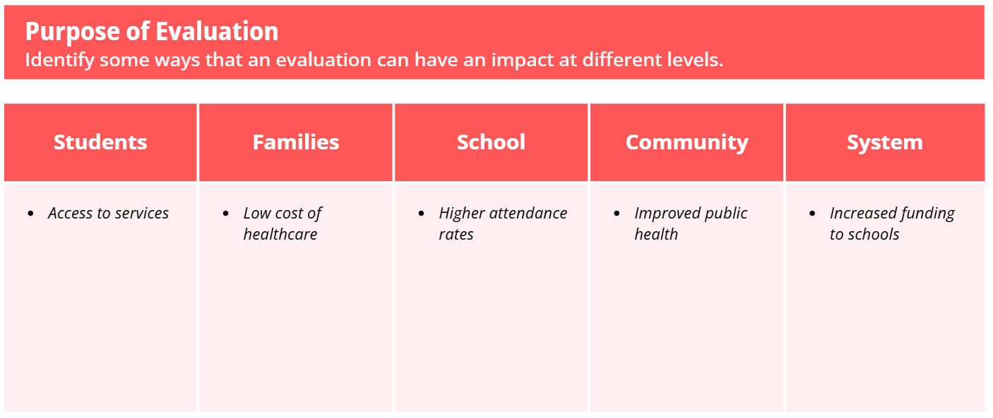
Purpose of Evaluation

Slide 13
Benefits to Evaluation
Reflection – learn what works (and doesn't!) in real time
Transparency – share results openly to build trust
Process improvement – optimize workflows for better service delivery
Measure outcomes – quantify clearly
Notes:
All evaluation gives your implementation team the opportunity to reflect on the work, improve transparency and processes, gather outcomes and impact data to leverage additional funding or respond to community members who have concerns, and to ultimately disseminate what they've learned. Evaluation can be a meaningful and impactful way to investigate the complexities of SBHC implementation and make sense of the challenges and innovation that occurred.

Slide 14
Benefits to Evaluation (Con't)
Assess impact – attribute changes due to SBHC
Understand complexities of implementation – reveal barriers to facilitate success
Accountability – demonstrate responsible stewardship
Alignment – ensure stakeholder priorities stay in sync
Notes:
All evaluation gives your implementation team the opportunity to reflect on the work, improve transparency and processes, gather outcomes and impact data to leverage additional funding or respond to community members who have concerns, and to ultimately disseminate what they've learned. Evaluation can be a meaningful and impactful way to investigate the complexities of SBHC implementation and make sense of the challenges and innovation that occurred.

Slide 15
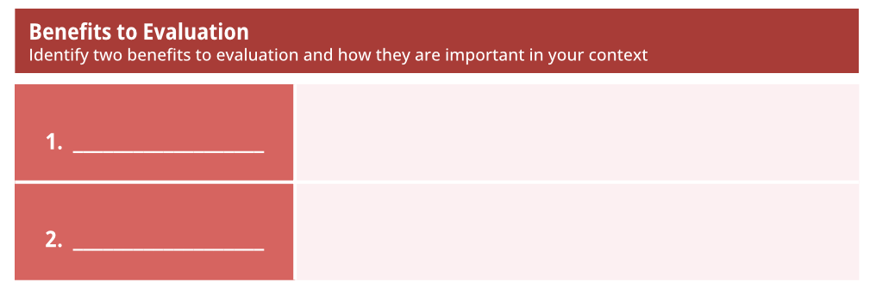
Benefits to Evaluation
Notes:
All evaluation gives your implementation team the opportunity to reflect on the work, improve transparency and processes, gather outcomes and impact data to leverage additional funding or respond to community members who have concerns, and to ultimately disseminate what they've learned. Evaluation can be a meaningful and impactful way to investigate the complexities of SBHC implementation and make sense of the challenges and innovation that occurred.

Slide 16
Types of Evaluation
Needs assessment
  What types of services do students in our community need?
  What are the differences in needs within the student population?
  What are the available resources, if any, to meet these needs?
  Is our SBHC still meeting the needs of our students?
  What has changed since the last time we did a needs assessment?
Notes:
The types of evaluation may involve needs assessment, process evaluation, outcomes, or impact evaluation. Needs assessments are typically conducted at the beginning stage of implementation and can be a useful tool to understand the needs of your community within the context of the educational and health services systems locally. Needs assessments utilize existing administrative, provider, and community data to create a picture of the service and needs landscape. Needs assessment questions may include "what types of services do students in our community need?" "What are the differences in needs within the student population?" and "What are the available resources in the community to meet these needs?". Process evaluations are useful to understand how implementation has occurred and if it aligns with how the SBHC was designed or intended to be implemented. Process evaluation can support improving or streamlining service provision as well as SBHC implementation processes such as data collection and reporting. Typical questions may include "what are the circumstance under which the SBHC implementation occurred?", "have implementation activities aligned with the intended planning process and initial timelines?", or "which services are being utilized in ways that were predicted and which are not?". Answering process evaluation questions may include quantitative data but often have strong descriptions and qualitative data can support your understanding of implementation. Please provide an example from your work!

Slide 17
Types of Evaluation (Con't)
Process evaluation
  What are the circumstances under which the SBHC implementation occurred?
  Have implementation activities aligned with the intended planning process and initial timelines?
  Which services are being utilized in ways that were predicted, and which are not?
  Are SBHC workflows working as intended?
  Example: School-Based Health Centers: Statewide Quality Improvement Program⁹
Notes:
The types of evaluation may involve needs assessment, process evaluation, outcomes, or impact evaluation. Needs assessments are typically conducted at the beginning stage of implementation and can be a useful tool to understand the needs of your community within the context of the educational and health services systems locally. Needs assessments utilize existing administrative, provider, and community data to create a picture of the service and needs landscape. Needs assessment questions may include "what types of services do students in our community need?" "What are the differences in needs within the student population?" and "What are the available resources in the community to meet these needs?". Process evaluations are useful to understand how implementation has occurred and if it aligns with how the SBHC was designed or intended to be implemented. Process evaluation can support improving or streamlining service provision as well as SBHC implementation processes such as data collection and reporting. Typical questions may include "what are the circumstance under which the SBHC implementation occurred?", "have implementation activities aligned with the intended planning process and initial timelines?", or "which services are being utilized in ways that were predicted and which are not?". Answering process evaluation questions may include quantitative data but often have strong descriptions and qualitative data can support your understanding of implementation.

Slide 18
Types of Evaluation (Con't)
Outcome evaluation
  What are the differences in a specific, measurable outcomes [e.g., medical visits, vision screenings] between SBHC served youth and their counterparts who did not receive SBHC care?
  Typically short-term, measurable at the end of a specified period [e.g. number of vision screenings in 1 year]
  Example: School-Based Health Centers: Improving Access and Quality of Care for Low-Income Adolescents¹⁰
Notes:
Outcome evaluations are structured to answer questions about how your targeted outcomes are affected by SBHC activities. Outcome evaluations rely on data that are collected to understand these effects and SBHC's should be direct about data collection early in the planning and implementation process. A comparison population is critical to understanding SBHC effects on student outcomes and consideration of a comparison population should happen as soon as possible. Consider how your evaluation team will acquire comparison data. For example, if your SBHC services are provided at some but not all of the schools in a district, will you be able to access outcome data for students in schools that haven't received SBHC care? Is there a way to collect data from all students to do so? Comparison groups can be critical to demonstrating effects of an intervention but there are statistical methods that can approximate a comparison group if your team is unable to manage data acquisition or simply cannot do so. It can be helpful to work with professional evaluation teams who have a statistician or skilled program evaluator on staff for outcome evaluations but it is not required if you have a data savvy team or consultant who can support your efforts. Impact evaluations consider the overall effect of SBHC's on a specific problem or identified need. Consider questions related to the impact of the SBHC on costs to the larger medical system or a specific condition, such as pregnancy or sexually transmitted infections.

Slide 19
Types of Evaluation (Con't)
Impact evaluation
  What broader, more long-term, often indirect impacts has the SBHC had on the community?
  How did the cost of SBHC care compare with care provided at a specific medical system or practice environment?
  What are the differences in pregnancy rates before and one-year after SBHC implementation in a specific geography?
  Example: Impact of School-based Health Centers on Children with Asthma¹¹
Notes:
Outcome evaluations are structured to answer questions about how your targeted outcomes are affected by SBHC activities. Outcome evaluations rely on data that are collected to understand these effects and SBHC's should be direct about data collection early in the planning and implementation process. A comparison population is critical to understanding SBHC effects on student outcomes and consideration of a comparison population should happen as soon as possible. Consider how your evaluation team will acquire comparison data. For example, if your SBHC services are provided at some but not all of the schools in a district, will you be able to access outcome data for students in schools that haven't received SBHC care? Is there a way to collect data from all students to do so? Comparison groups can be critical to demonstrating effects of an intervention but there are statistical methods that can approximate a comparison group if your team is unable to manage data acquisition or simply cannot do so. It can be helpful to work with professional evaluation teams who have a statistician or skilled program evaluator on staff for outcome evaluations but it is not required if you have a data savvy team or consultant who can support your efforts. Impact evaluations consider the overall effect of SBHC's on a specific problem or identified need. Consider questions related to the impact of the SBHC on costs to the larger medical system or a specific condition, such as pregnancy or sexually transmitted infections.

Slide 20
Types of Evaluation
Helpful resources describing SBHC evaluations, with worksheets and activities to help you prepare and plan for evaluation: A Guidebook for Evaluating School-Based Health Centers⁶ and Measuring Success: Evaluation Designs and Approaches to Assessing the Impact of School-Based Health Centers⁷
Notes:
Outcome evaluations are structured to answer questions about how your targeted outcomes are affected by SBHC activities. Outcome evaluations rely on data that are collected to understand these effects and SBHC's should be direct about data collection early in the planning and implementation process. A comparison population is critical to understanding SBHC effects on student outcomes and consideration of a comparison population should happen as soon as possible. Consider how your evaluation team will acquire comparison data. For example, if your SBHC services are provided at some but not all of the schools in a district, will you be able to access outcome data for students in schools that haven't received SBHC care? Is there a way to collect data from all students to do so? Comparison groups can be critical to demonstrating effects of an intervention but there are statistical methods that can approximate a comparison group if your team is unable to manage data acquisition or simply cannot do so. It can be helpful to work with professional evaluation teams who have a statistician or skilled program evaluator on staff for outcome evaluations but it is not required if you have a data savvy team or consultant who can support your efforts. Impact evaluations consider the overall effect of SBHC's on a specific problem or identified need. Consider questions related to the impact of the SBHC on costs to the larger medical system or a specific condition, such as pregnancy or sexually transmitted infections.

Slide 21
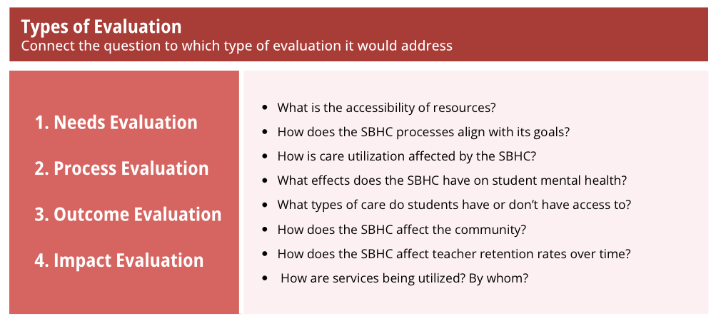
Types of Evaluation

Slide 22
Types of Evaluation

Slide 23
Think About Your Evaluation...
Write down your question
Purpose
Scope
Data
Stakeholders
Governance/Roles
Identifying Data Needs & Capabilities
Notes:
Think about an evaluation you'd want to implement
Pick a question that you're most interested in investigating at your SBHC
In the next few slides, we will review these items and give you the chance to start to think through what this might look like for your evaluation

Slide 24
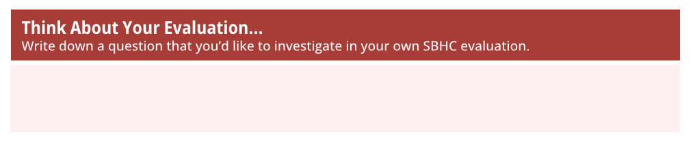
Think About Your Evaluation...

Slide 25
Think About Your Evaluation...

Slide 26
Preparing for Evaluation
Clarify Purpose & Scope
Purpose:
  Goals/objects to accomplish
Scope:
  What can be achieved with the time and resources available
Notes:
Define why you're evaluating (accountability to funder, program improvements, etc.)
Set clear, measurable evaluation questions; be explicit
Short grant-cycle deliverables and longer-term impact tracking
These four points are four sides of the same process. Research questions will form in the space between what stakeholders need, what data is available, and what the overall purpose of the evaluation is. Evaluations don't always get to be planned before program implementation, which can add limits to data management and collection - but that's only one more constraint – and sometimes constraints can help by reducing how many decisions have to be made.
Governance helps define how the SBHC feedback loop feeds into system-wide decision-making and how those streams of work relate

Slide 27
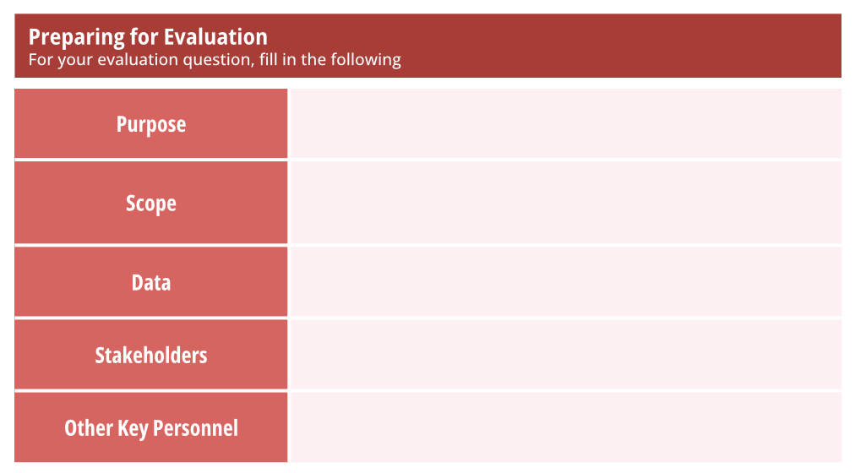
Preparing for Evaluation
Notes:
Define why you're evaluating (accountability to funder, program improvements, etc.)
Set clear, measurable evaluation questions; be explicit
Short grant-cycle deliverables and longer-term impact tracking
These four points are four sides of the same process. Research questions will form in the space between what stakeholders need, what data is available, and what the overall purpose of the evaluation is. Evaluations don't always get to be planned before program implementation, which can add limits to data management and collection - but that's only one more constraint – and sometimes constraints can help by reducing how many decisions have to be made.
Governance helps define how the SBHC feedback loop feeds into system-wide decision-making and how those streams of work relate

Slide 28
Preparing for Evaluation
Notes:
Define why you're evaluating (accountability to funder, program improvements, etc.)
Set clear, measurable evaluation questions; be explicit
Short grant-cycle deliverables and longer-term impact tracking
These four points are four sides of the same process. Research questions will form in the space between what stakeholders need, what data is available, and what the overall purpose of the evaluation is. Evaluations don't always get to be planned before program implementation, which can add limits to data management and collection - but that's only one more constraint – and sometimes constraints can help by reducing how many decisions have to be made.
Governance helps define how the SBHC feedback loop feeds into system-wide decision-making and how those streams of work relate

Slide 29
Preparing for Evaluation (Con't)
Assess Data & Data Management
  Inventory existing data, decide what new data might be collected, ensure your intended use addresses the big C's: Consent, Confidentiality, and (legal) Compliance
Notes:
These four points are four sides of the same process. Research questions will form in the space between what stakeholders need, what data is available, and what the overall purpose of the evaluation is. Evaluations don't always get to be planned before program implementation, which can add limits to data management and collection - but that's only one more constraint – and sometimes constraints can help by reducing how many decisions have to be made.
Governance helps define how the SBHC feedback loop feeds into system-wide decision-making and how those streams of work relate

Slide 30
Preparing for Evaluation
Notes:
Define why you're evaluating (accountability to funder, program improvements, etc.)
Set clear, measurable evaluation questions; be explicit
Short grant-cycle deliverables and longer-term impact tracking
These four points are four sides of the same process. Research questions will form in the space between what stakeholders need, what data is available, and what the overall purpose of the evaluation is. Evaluations don't always get to be planned before program implementation, which can add limits to data management and collection - but that's only one more constraint – and sometimes constraints can help by reducing how many decisions have to be made.
Governance helps define how the SBHC feedback loop feeds into system-wide decision-making and how those streams of work relate

Slide 31
Preparing for Evaluation
Notes:
Define why you're evaluating (accountability to funder, program improvements, etc.)
Set clear, measurable evaluation questions; be explicit
Short grant-cycle deliverables and longer-term impact tracking
These four points are four sides of the same process. Research questions will form in the space between what stakeholders need, what data is available, and what the overall purpose of the evaluation is. Evaluations don't always get to be planned before program implementation, which can add limits to data management and collection - but that's only one more constraint – and sometimes constraints can help by reducing how many decisions have to be made.
Governance helps define how the SBHC feedback loop feeds into system-wide decision-making and how those streams of work relate

Slide 32
Preparing for Evaluation (Con't)
Engage Stakeholders (early and often)
  Identify who you need to make this work and what they need from it
Notes:
These four points are four sides of the same process. Research questions will form in the space between what stakeholders need, what data is available, and what the overall purpose of the evaluation is. Evaluations don't always get to be planned before program implementation, which can add limits to data management and collection - but that's only one more constraint – and sometimes constraints can help by reducing how many decisions have to be made.
Governance helps define how the SBHC feedback loop feeds into system-wide decision-making and how those streams of work relate

Slide 33
Preparing for Evaluation
Notes:
Define why you're evaluating (accountability to funder, program improvements, etc.)
Set clear, measurable evaluation questions; be explicit
Short grant-cycle deliverables and longer-term impact tracking
These four points are four sides of the same process. Research questions will form in the space between what stakeholders need, what data is available, and what the overall purpose of the evaluation is. Evaluations don't always get to be planned before program implementation, which can add limits to data management and collection - but that's only one more constraint – and sometimes constraints can help by reducing how many decisions have to be made.
Governance helps define how the SBHC feedback loop feeds into system-wide decision-making and how those streams of work relate

Slide 34
Preparing for Evaluation
Notes:
Define why you're evaluating (accountability to funder, program improvements, etc.)
Set clear, measurable evaluation questions; be explicit
Short grant-cycle deliverables and longer-term impact tracking
These four points are four sides of the same process. Research questions will form in the space between what stakeholders need, what data is available, and what the overall purpose of the evaluation is. Evaluations don't always get to be planned before program implementation, which can add limits to data management and collection - but that's only one more constraint – and sometimes constraints can help by reducing how many decisions have to be made.
Governance helps define how the SBHC feedback loop feeds into system-wide decision-making and how those streams of work relate

Slide 35
Preparing for Evaluation (Con't)
Establish Governance and Roles
  Collaboration requires clear lines – who is responsible for what, and who makes what decisions
Notes:
These four points are four sides of the same process. Research questions will form in the space between what stakeholders need, what data is available, and what the overall purpose of the evaluation is. Evaluations don't always get to be planned before program implementation, which can add limits to data management and collection - but that's only one more constraint – and sometimes constraints can help by reducing how many decisions have to be made.
Governance helps define how the SBHC feedback loop feeds into system-wide decision-making and how those streams of work relate

Slide 36
Preparing for Evaluation
Notes:
Define why you're evaluating (accountability to funder, program improvements, etc.)
Set clear, measurable evaluation questions; be explicit
Short grant-cycle deliverables and longer-term impact tracking
These four points are four sides of the same process. Research questions will form in the space between what stakeholders need, what data is available, and what the overall purpose of the evaluation is. Evaluations don't always get to be planned before program implementation, which can add limits to data management and collection - but that's only one more constraint – and sometimes constraints can help by reducing how many decisions have to be made.
Governance helps define how the SBHC feedback loop feeds into system-wide decision-making and how those streams of work relate

Slide 37
Preparing for Evaluation
Notes:
Define why you're evaluating (accountability to funder, program improvements, etc.)
Set clear, measurable evaluation questions; be explicit
Short grant-cycle deliverables and longer-term impact tracking
These four points are four sides of the same process. Research questions will form in the space between what stakeholders need, what data is available, and what the overall purpose of the evaluation is. Evaluations don't always get to be planned before program implementation, which can add limits to data management and collection - but that's only one more constraint – and sometimes constraints can help by reducing how many decisions have to be made.
Governance helps define how the SBHC feedback loop feeds into system-wide decision-making and how those streams of work relate

Slide 38
Elicit Stakeholder Needs
Identify your stakeholders and their information needs
  Funders (federal, state, local)
  School leadership
  Clinicians
  Community members
Notes:
There is an ocean of data in student information systems and in health records systems. The task is to determine and triage what questions your stakeholders want answered, how practical it is to answer those questions given existing data, staffing, funding and the on-the-ground logistics it takes to collect data with fidelity and quality. There will always be some overlap but there will also always be some negotiation to create an evaluation plan that can be executed on-time, within-budget, and respectful of the privacy and sensitivity of all those involved. It's not a level playing field – funders have explicit needs and those are rarely negotiable; so getting other partners to recognize and respect that will go a long way, and also help get other stakeholders coalesced around something firm.
Funders (federal, state, local) want program outcomes (changes in morbidity, services rendered), physical space/resource usage, demographics served, budget tracking, staffing and qualifications
School leadership want service counts (immunizations, screenings, dental exams), absenteeism rates
Clinicians want care quality and patient outcomes, workflow and access(average wait time, visit duration and throughput, cancellation rates), and referral and follow-up effectiveness
Community members can have varied wants, interests, and concerns. From safety to privacy to effectiveness and beyond.

Slide 39
Identify Data Needs / Capabilities
Early planning and communication are critical to secure data sources
Data Governance Considerations
Notes:
The process of coming up with evaluation questions inevitably involves the question "do we already or can we even measure that?" It's good to have people at the table who are familiar with the data and with the daily process so you can ensure that 1) the data really means what you think it does, and 2) if we don't have it, our plan to implement matches reality. Clinicians and school staff have fairly rigid workflows and introducing new work needs to be well planned. Not only well planned but there needs to be buy-in and clear expectations. If you're asking staff to record new information there needs to be thoughtful training to ensure that all parties know what information is being collected and why – especially why, as there will always be more outliers than you expect and staff will need to know how to handle those situations (reporting back, recording differently). If you can't convince a clinician it's important to tick an extra box on a form, or to collect paper attestations, then consider that it likely won't be done consistently and you might need to reframe something in your approach. Every one is juggling a myriad of tasks. If you're bringing a new one it better replace some existing process (hopefully in a more efficient way) or bring enough value to overcome any resistance..
Early planning and communication are critical to secure data sources
Do we already collect this, and where? How do we export it?
Do we need to collect this, and how? Can we build this into the necessary system, is it a burden, is it HIPAA/FERPA compliant?
Stakeholder mapping – link data outputs, questions, and audiences(clinicians, schools, funders, community)
Metadata & data governance
Data sources & collection methods: MIS, SIS, surveys, audits, focus-group and interview transcripts, public datasets (CDC, Census, YRBSS)
Who is collecting, how is it being collected, can we maintain quality and fidelity?
Time to figure out: dates of service, reporting periods
Units of analysis: students-level vs. aggregate
Privacy & Consent – not just FERPA HIPAA but any additional consent required of your evaluators or evaluation team to conduct their work

Slide 40
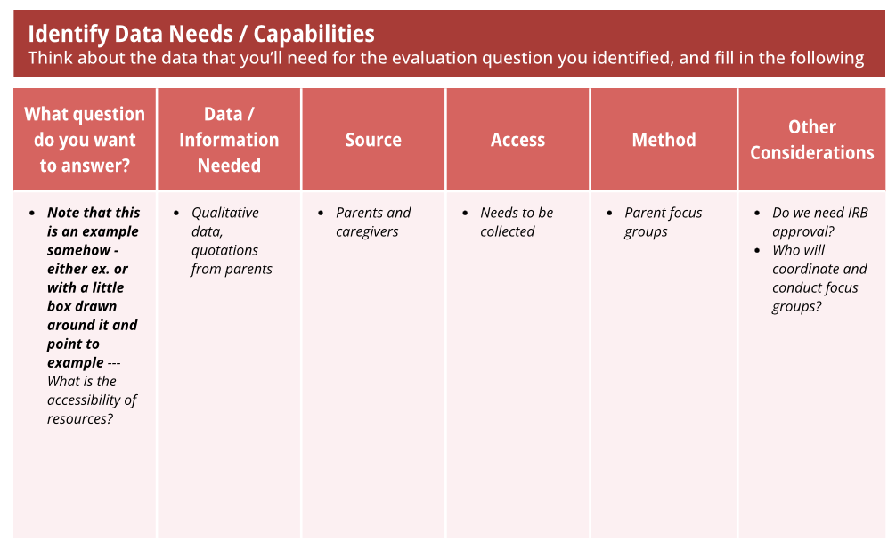
Identify Data Needs / Capabilities

Slide 41
Identify Data Needs / Capabilities

Slide 42
Information for Needs Assessments
What are the differences in needs within the student population? Is our SBHC meeting the needs?
  Demographics & socio-economic status
  Health status & academic factors
  Community resources
  Stakeholder input
Notes:
Demographics & socio-economic status
Age, grade
Health status & academic factors
Chronic conditions, (dis)ability status
Attendance, GPA, involvement in AP courses or special education
Community resources
Existing clinics, coverage gaps
Stakeholder input
Surveys, focus groups, and key-informant interviews

Slide 43
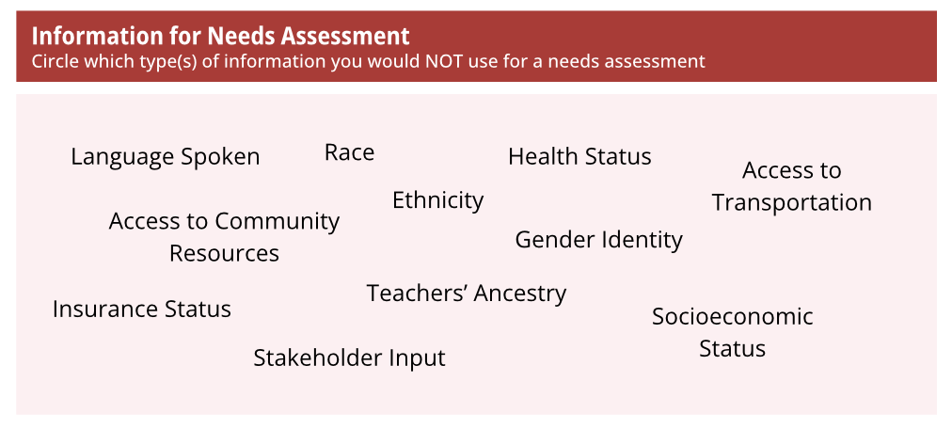
Information for Needs Assessments
Notes:
Demographics & socio-economic status
Age, grade
Health status & academic factors
Chronic conditions, (dis)ability status
Attendance, GPA, involvement in AP courses or special education
Community resources
Existing clinics, coverage gaps
Stakeholder input
Surveys, focus groups, and key-informant interviews

Slide 44
Information for Needs Assessments
Notes:
Demographics & socio-economic status
Age, grade
Health status & academic factors
Chronic conditions, (dis)ability status
Attendance, GPA, involvement in AP courses or special education
Community resources
Existing clinics, coverage gaps
Stakeholder input
Surveys, focus groups, and key-informant interviews

Slide 45
Information for Process Evaluations
What circumstances underlay SBHC implementation?
  Service utilization metrics
  Operational indicators
  Policy & procedure compliance
  Equity measures
Notes:
Process evaluations focus much more on the mechanics of how programs are rolled out and how they perform. For SBHC, this means a heavier reliance on clinician and MIS data. Schools data can be included to provide context and to look at issues of equity in service delivery by identifying groups not well reached by the program.
Service utilization metrics
Visits per service type, follow-up completion rate
Operational indicators
Wait times, staffing qualifications, length of service
Policy & procedure compliance
Chart audits, MIS reports, quality assurance checklists
Equity measures
Subgroups served (age, grade, race/ethnicity, gender, (dis)ability status, etc.)

Slide 46
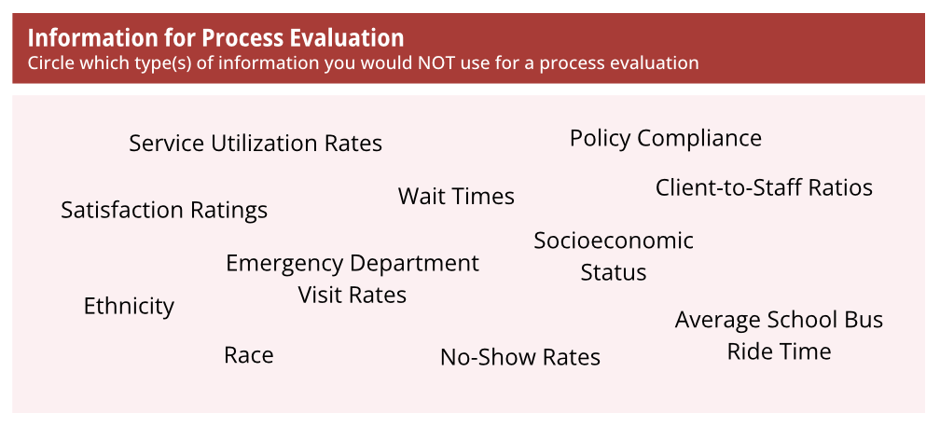
Information for Process Evaluations
Notes:
Process evaluations focus much more on the mechanics of how programs are rolled out and how they perform. For SBHC, this means a heavier reliance on clinician and MIS data. Schools data can be included to provide context and to look at issues of equity in service delivery by identifying groups not well reached by the program.
Service utilization metrics
Visits per service type, follow-up completion rate
Operational indicators
Wait times, staffing qualifications, length of service
Policy & procedure compliance
Chart audits, MIS reports, quality assurance checklists
Equity measures
Subgroups served (age, grade, race/ethnicity, gender, (dis)ability status, etc.)

Slide 47
Information for Process Evaluations
Notes:
Process evaluations focus much more on the mechanics of how programs are rolled out and how they perform. For SBHC, this means a heavier reliance on clinician and MIS data. Schools data can be included to provide context and to look at issues of equity in service delivery by identifying groups not well reached by the program.
Service utilization metrics
Visits per service type, follow-up completion rate
Operational indicators
Wait times, staffing qualifications, length of service
Policy & procedure compliance
Chart audits, MIS reports, quality assurance checklists
Equity measures
Subgroups served (age, grade, race/ethnicity, gender, (dis)ability status, etc.)

Slide 48
Information for Outcome Evaluations
What are the differences between SBHC-served youth and counterparts?
  Short-term / proximal indicators
  Intermediate outcomes
  Long-term / distal impacts
  Unintended effects
Notes:
Short term indicators are best captured directly through surveys, quizes, or focus groups compared to passively through data systems. Changes in perception can be measured with pre and post instruments, skill acquisition can be captured with short quizzes or observation from clinicians (proper inhaler usage) or educators (proper hand washing). Measures of intent ("I intend to wear my seat belt" or "I intend to stay away from drugs and alcohol") can be required by a funder, though not of much practical use but can be easily collected with a signed pledge. It comes with the time cost of managing signed pledges or recording the information in some way – a real imbalance of effort expended and outcome achieved - another reason to avoid if not required.
Short-term / proximal indicators
Changes in health knowledge, attitudes, skills
Intermediate outcomes
Self-report behavior change, treatment adherence
Long-term / distal impacts
Morbidity rates, emergency service utilization, resource utilization rates
Unintended effects
Patterns of overuse and class-time lost
Potential premature exposure

Slide 49
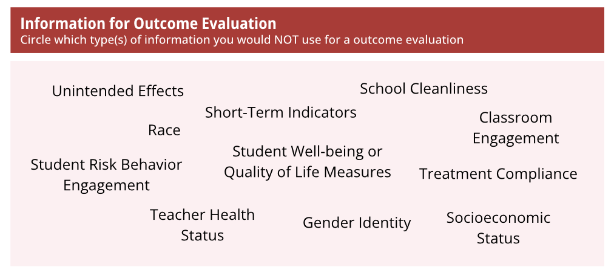
Information for Outcome Evaluations
Notes:
Short term indicators are best captured directly through surveys, quizzes, or focus groups compared to passively through data systems. Changes in perception can be measured with pre and post instruments, skill acquisition can be captured with short quizzes or observation from clinicians (proper inhaler usage) or educators (proper hand washing). Measures of intent ("I intend to wear my seat belt" or "I intend to stay away from drugs and alcohol") can be required by a funder, though not of much practical use but can be easily collected with a signed pledge. It comes with the time cost of managing signed pledges or recording the information in some way – a real imbalance of effort expended and outcome achieved - another reason to avoid if not required.
Short-term / proximal indicators
Changes in health knowledge, attitudes, skills
Intermediate outcomes
Self-report behavior change, treatment adherence
Long-term / distal impacts
Morbidity rates, emergency service utilization, resource utilization rates
Unintended effects
Patterns of overuse and class-time lost
Potential premature exposure

Slide 50
Information for Outcome Evaluations
Notes:
Short term indicators are best captured directly through surveys, quizzes, or focus groups compared to passively through data systems. Changes in perception can be measured with pre and post instruments, skill acquisition can be captured with short quizzes or observation from clinicians (proper inhaler usage) or educators (proper hand washing). Measures of intent ("I intend to wear my seat belt" or "I intend to stay away from drugs and alcohol") can be required by a funder, though not of much practical use but can be easily collected with a signed pledge. It comes with the time cost of managing signed pledges or recording the information in some way – a real imbalance of effort expended and outcome achieved - another reason to avoid if not required.
Short-term / proximal indicators
Changes in health knowledge, attitudes, skills
Intermediate outcomes
Self-report behavior change, treatment adherence
Long-term / distal impacts
Morbidity rates, emergency service utilization, resource utilization rates
Unintended effects
Patterns of overuse and class-time lost
Potential premature exposure

Slide 51
Information for Impact Evaluations
What are the differences across treatment and time?
  Program exposure
  Comparison data
  Baseline & follow-up
  Covariates and risk adjustors
Notes:
Types of services received and how you categorize will depend on service offerings and patterns that arise after implementation. If students only seek out one or two of your intended categories you might need to investigate if it's possible to break those into sub categories.
The comparison data is critical for evaluation. Not being able to isolate students who did not engage in services, and especially students who were not able as those services weren't available will prevent you from any evaluation – in those instances you'll be reporting outcomes but not impacts.
Socio-economic status, pre-existing conditions, academic performance or attendance, home and community factors – accounting for factors outside of service that could influence outcomes adds strength to your evaluation
Program exposure
Types of services received, frequency, duration
Comparison data
Matched data points for students who didn't receive services or in schools where services weren't available
Baseline & follow-up
Having pre- and post-values for your outcomes are key
Can have multiple post-intervention intervals (6 months, 12 months, etc.)
Covariates and risk adjustors
Socio-economic status, comorbidities, academic performance, home and community factors

Slide 52
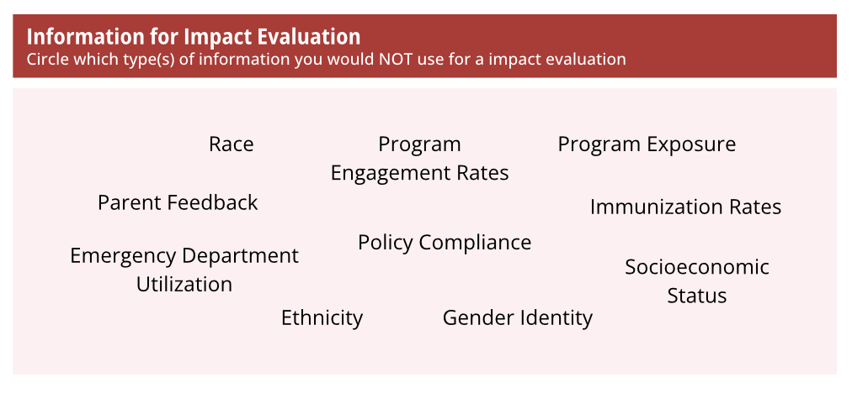
Information for Impact Evaluations
Notes:
Types of services received and how you categorize will depend on service offerings and patterns that arise after implementation. If students only seek out one or two of your intended categories you might need to investigate if it's possible to break those into sub categories.
The comparison data is critical for evaluation. Not being able to isolate students who did not engage in services, and especially students who were not able as those services weren't available will prevent you from any evaluation – in those instances you'll be reporting outcomes but not impacts.
Socio-economic status, pre-existing conditions, academic performance or attendance, home and community factors – accounting for factors outside of service that could influence outcomes adds strength to your evaluation
Program exposure
Types of services received, frequency, duration
Comparison data
Matched data points for students who didn't receive services or in schools where services weren't available
Baseline & follow-up
Having pre- and post-values for your outcomes are key
Can have multiple post-intervention intervals (6 months, 12 months, etc.)
Covariates and risk adjustors
Socio-economic status, comorbidities, academic performance, home and community factors

Slide 53
Information for Impact Evaluations
Notes:
Types of services received and how you categorize will depend on service offerings and patterns that arise after implementation. If students only seek out one or two of your intended categories you might need to investigate if it's possible to break those into sub categories.
The comparison data is critical for evaluation. Not being able to isolate students who did not engage in services, and especially students who were not able as those services weren't available will prevent you from any evaluation – in those instances you'll be reporting outcomes but not impacts.
Socio-economic status, pre-existing conditions, academic performance or attendance, home and community factors – accounting for factors outside of service that could influence outcomes adds strength to your evaluation
Program exposure
Types of services received, frequency, duration
Comparison data
Matched data points for students who didn't receive services or in schools where services weren't available
Baseline & follow-up
Having pre- and post-values for your outcomes are key
Can have multiple post-intervention intervals (6 months, 12 months, etc.)
Covariates and risk adjustors
Socio-economic status, comorbidities, academic performance, home and community factors

Slide 54
Challenges in Evaluation
Divergent scopes & partner roles
HIPAA and FERPA dual compliance
Motivation & funding constraints
Data sharing
Notes:
All partnership and collaborative work has challenges and benefits. Challenges may include fundamental differences in the scope or role of the partner. For example, school systems focus on learning, cognition, social-emotional, and executive functioning skills while healthcare providers generally focus on physical and mental health needs, immunizations and other public health concerns. These differences are manifested in the type of service provided, regulatory bodies who hold partners accountable, documentation requirements, as well as privacy and confidentiality requirements.
Some partners must demonstrate HIPAA compliance, and others must follow FERPA guidelines. The roles for data collection, mandatory reporting, and who has privacy rights and who has data access differ across these sets of regulations, as well as State law, professional codes of ethics, and local rulemaking.
Motivation to partner, funding constraints on staff time and facility resources, as well as considerations at the district and school levels can all impact partnership. In such narrow spaces there is real competition for attention and resources, across the backdrop of funding and decision making cycles that struggle to accept waiting on a scale greater than one year to see impacts.
Sharing data can feel overwhelming and there are often concerns about who has access, where shared data lives and who is responsible for it, privacy and confidentiality protections, and just the on-the-ground work of getting data systems to talk to each other.
Divergent scopes & partner roles
Attendance, academics for schools; care quality, workflow for clinicians; outcomes and compliance for funders
HIPAA and FERPA dual compliance
Complex consent and privacy rights navigation, Unifying de-identification standards
Motivation & funding constraints
Short grant cycles vs. Impacts being longer-term
Competing priorities for limited resources
Data sharing
Unclear data ownership, data and system interoperability, security controls

Slide 55
Using Evaluation Findings
Dissemination strategy tied to evaluation purpose
Needs assessments: advocacy, policy change, funding
Process evaluation: process improvement, accountability
Outcome evaluation: inform practice recommendations
Impact evaluation: advocacy, policy change, funding, develop novel interventions
Notes:
It is important to situate the findings from your work within the broader purpose of your evaluation. Needs assessments can be useful for advocacy work, funding requests, or lobbying for policy change. If your evaluation was intended to support process or quality improvement of your SBHC, perhaps findings are turned into actionable steps to improve these processes over time. If the purpose of your evaluation was to evaluate and measure specific health outcomes in a population of youth, these findings may support efforts of other SBHCs focusing on clinical needs. Presenting to annual meetings at professional organizations and conferences would support your connecting with these clinics directly to share learnings. Impact evaluations can also support advocacy or policy change efforts, funding requests to expand or build new SBHCs, or to innovate and develop new interventions.

Slide 56
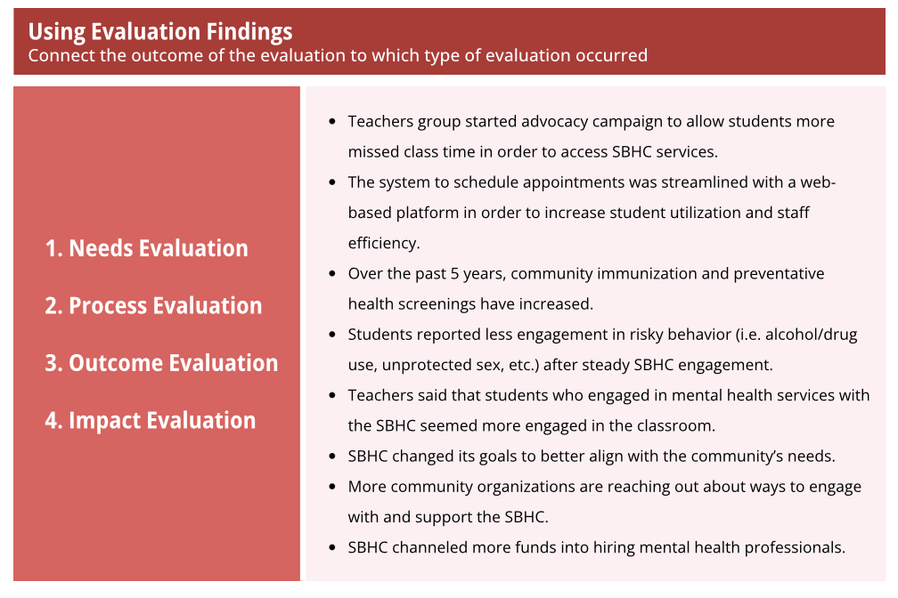
Using Evaluation Findings
Notes:
It is important to situate the findings from your work within the broader purpose of your evaluation. Needs assessments can be useful for advocacy work, funding requests, or lobbying for policy change. If your evaluation was intended to support process or quality improvement of your SBHC, perhaps findings are turned into actionable steps to improve these processes over time. If the purpose of your evaluation was to evaluate and measure specific health outcomes in a population of youth, these findings may support efforts of other SBHCs focusing on clinical needs. Presenting to annual meetings at professional organizations and conferences would support your connecting with these clinics directly to share learnings. Impact evaluations can also support advocacy or policy change efforts, funding requests to expand or build new SBHCs, or to innovate and develop new interventions.

Slide 57
Using Evaluation Findings
Notes:
It is important to situate the findings from your work within the broader purpose of your evaluation. Needs assessments can be useful for advocacy work, funding requests, or lobbying for policy change. If your evaluation was intended to support process or quality improvement of your SBHC, perhaps findings are turned into actionable steps to improve these processes over time. If the purpose of your evaluation was to evaluate and measure specific health outcomes in a population of youth, these findings may support efforts of other SBHCs focusing on clinical needs. Presenting to annual meetings at professional organizations and conferences would support your connecting with these clinics directly to share learnings. Impact evaluations can also support advocacy or policy change efforts, funding requests to expand or build new SBHCs, or to innovate and develop new interventions.

Slide 58
Ready to Begin?
First steps:
  Consider the research questions you want to address
  Establish a team and engage stakeholders early
Questions?
  Contact us!
    216-368-3424
    PovertyCenter@case.edu

Slide 59
Thank You!
Educational Service Center of Northeast Ohio – funder
Ohio School-Based Health Alliance
School-Based Health Center Steering Committee: The Gund Foundation, MetroHealth / Better Health Partnership, Ohio Dept of Mental Health, Northeast Ohio school superintendents,

Slide 60

References

Slide 61
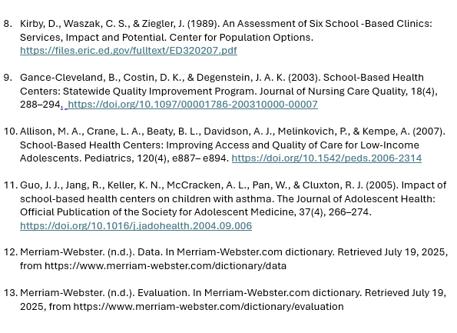
References (Con't)

Slide 62
Additional Resources
Resources:
  Brindis, C.D., Kaplan, D.W., Phibbs, S.L. (n.d.). A Guidebook for Evaluating School-Based Health Centers. http://ww2.nasbhc.org/RoadMap/PlanningandEvaluation/Evaluation/Guidebook%20for%20Evaluating%20SBHCs.pdf
  Bersamin, M., Garbers, S., Gold, M. A., Heitel, J., Martin, K., Fisher, D. A., & Santelli, J. (2016). Measuring Success: Evaluation Designs and Approaches to Assessing the Impact of School-Based Health Centers. The Journal of Adolescent Health : Official Publication of the Society for Adolescent Medicine, 58(1), 3–10. https://doi.org/10.1016/j.jadohealth.2015.09.018
  Hackbarth, D., & Gall, G. B. (2005). Evaluation of School-Based Health Center Programs and Services: the Whys and Hows of Demonstrating Program Effectiveness. Nursing Clinics of North America, 40(4), 711–724. https://doi.org/10.1016/j.cnur.2005.07.008
Examples:
  Allison, M. A., Crane, L. A., Beaty, B. L., Davidson, A. J., Melinkovich, P., & Kempe, A. (2007). School-based health centers: improving access and quality of care for low-income adolescents. Pediatrics, 120(4), e887–e894. https://doi.org/10.1542/peds.2006-2314
  Walker, S. C., Kerns, S. E., Lyon, A. R., Bruns, E. J., & Cosgrove, T. J. (2010). Impact of School-Based Health Center use on academic outcomes. The Journal of adolescent health : official publication of the Society for Adolescent Medicine, 46(3), 251–257. https://doi.org/10.1016/j.jadohealth.2009.07.002

